Slide 1



How To Use Kaizen Application
Follow this ppt to know more.
Prepared by : NVTI IT

Slide 2
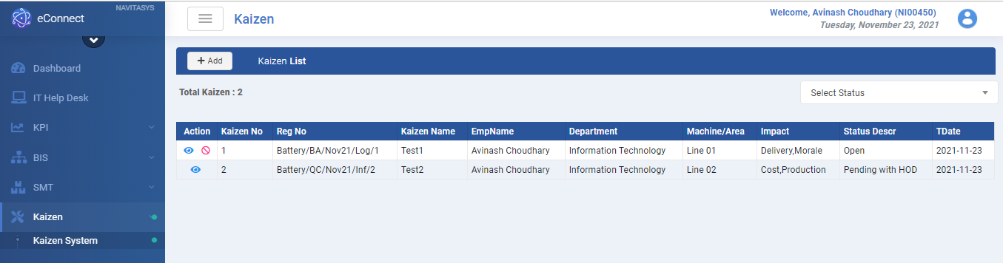
Kaizen List

Slide 3
Points to Remember :
On clicking on Add button, it will give you a form to fill all necessary kaizen details.
On selecting From & To dates, you can set filter to find out your Kaizen’s between any two dates.
On selecting Status, you can find Kaizen’s of a particular status.
You can also search in the Search box on the upper left side.
On clicking Download, you can download an excel file.
On clicking the eye button, you can View/Edit your Kaizen depending on the status.
On clicking the block button, you can cancel your Kaizen (only when it is not Posted).

Slide 4
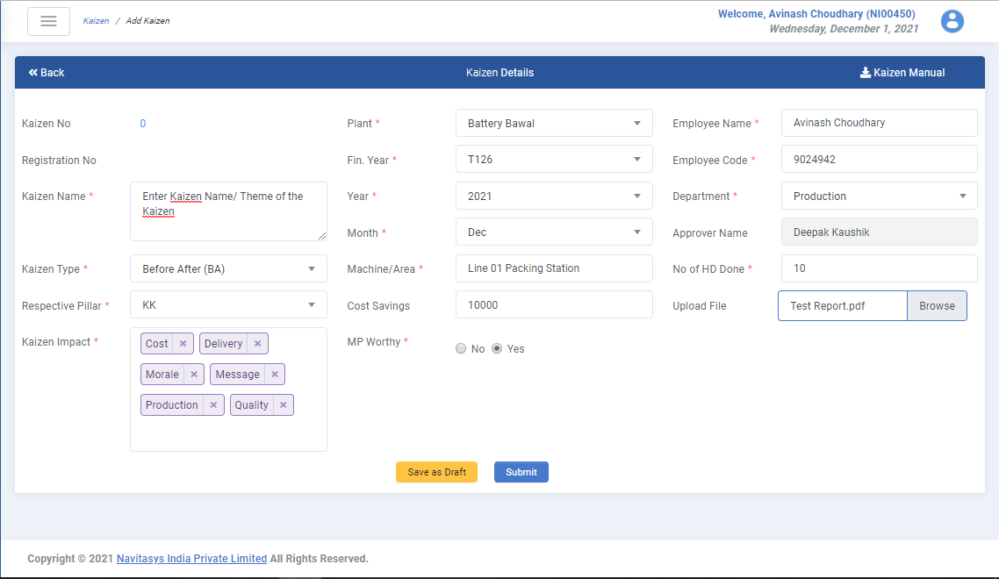
Add Kaizen :
On clicking, it saves your data in Open status. You can change it afterwards.
On clicking, it goes for Approver for approval. You can’t change it afterwards.

Slide 5
Fields :
1. Kaizen No : It is an auto-generated number.
2. Kaizen Registration Number : It is also an auto-generated number. It is generated once you fill all the necessary details and save the form.
SMT/CK/DEC21/PRO/100
PLANT LOCATION
BATTERY
SMT
KAIZEN TYPE
BEFORE AFTER (BA)
COMPACT KAIZEN (CK)
QC STORY (QC)
MONTH &YEAR
FIRST 3 CHARACTERS OF MONTH WITH LAST 2 DIGITS OF YEAR (WITHOUT SPACE).
DEPARTMENT NAME
FIRST 3 CHARACTERS OF SELECTED DEPARTMENT NAME.
KAIZEN SERIES NUMBER
THIS WILL BE IN SERIES STARTING FROM 1 AND CONTINUING TILL THE END OF THE YEAR.

Slide 6
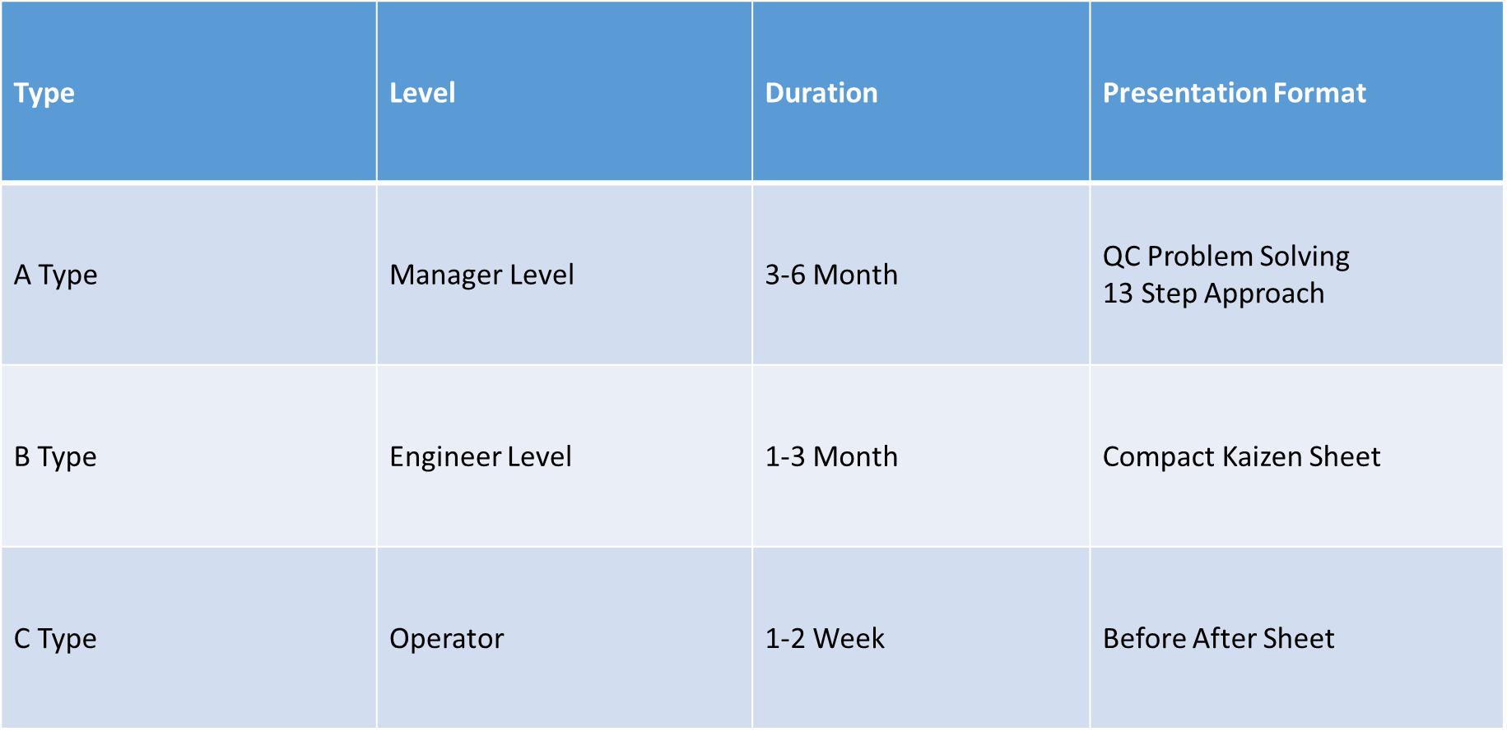
3. Kaizen Name : Enter Kaizen Name or the theme of the kaizen to briefly illustrate the kaizen you have done.
4. Kaizen Type : There are 3 types of Kaizen:
Before-After
Compact Kaizen
QC Story

Slide 7
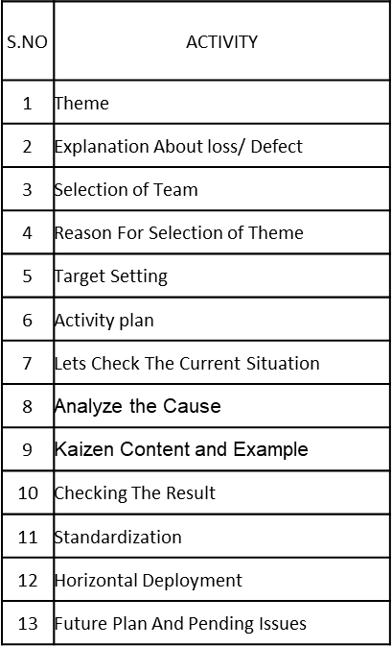
QC Problem Solving 13 Step Approach :

Slide 8
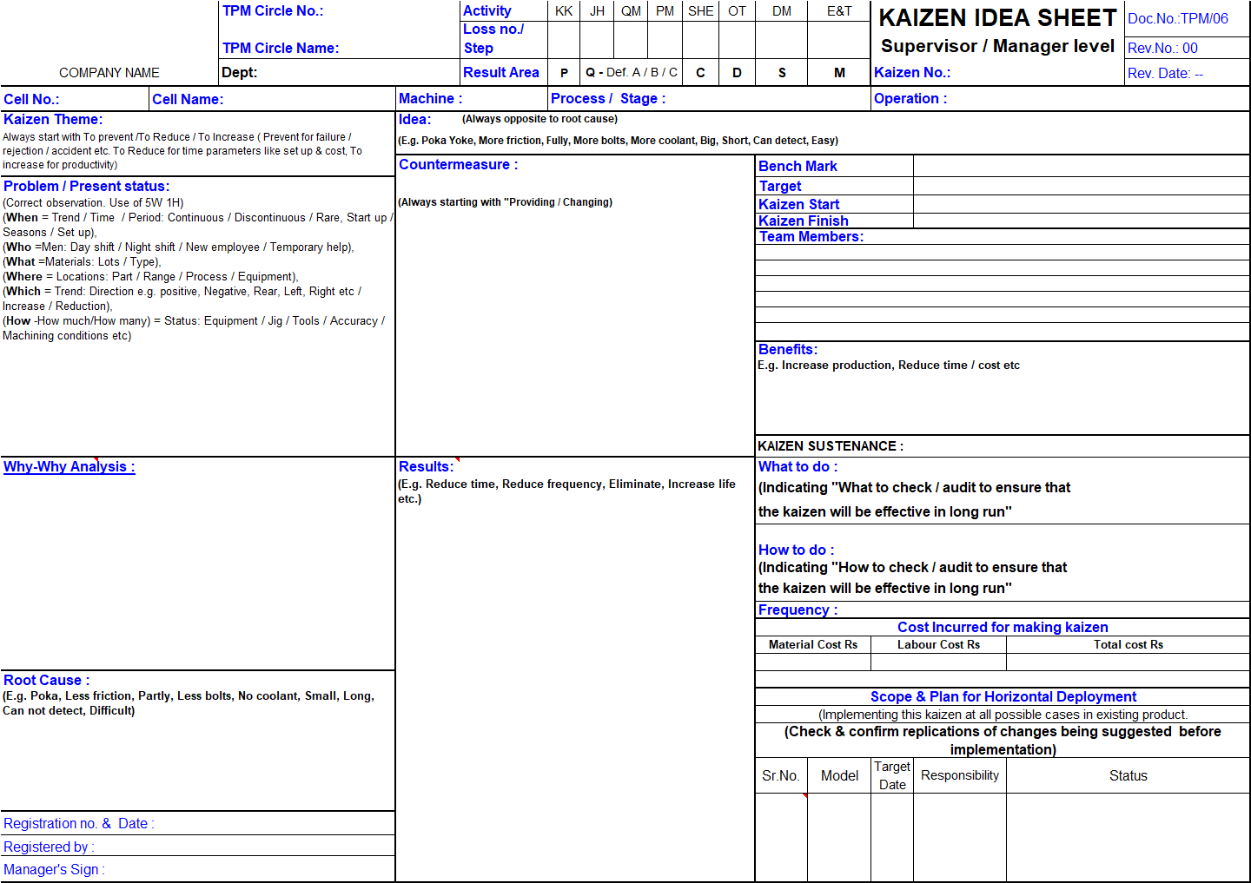
Compact Kaizen Sheet :

Slide 9
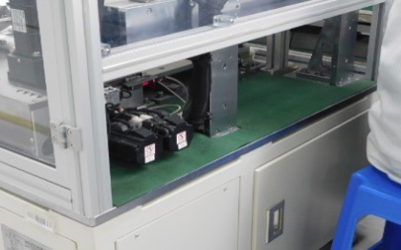
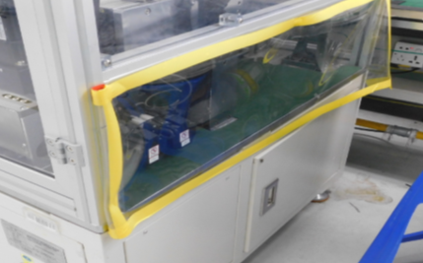
Before After :
BEFORE
AFTER
Abnormality :(Source of Contamination) Machine sideways are not covered and dust particle can enter in machine
Solution : Machine side is covered by sheet steadily to prevent dust particles from entering in machine
Know Why : May cause Quality defects
Tangible Benefit : None
Intangible Benefit: Cleaning time reduced

Slide 10
5. Respective Pillar : These are 7 TPM pillars. Select the relevant pillar according to your kaizen.
6. Kaizen Impact : Kindly select all relevant options your kaizen have an impact on. You can select multiple options simultaneously.
7. Plant : You can select the plant where you have done kaizen. It can be either Battery or SMT.
8. Fin Year : You have to select the financial year in which you have done the Kaizen. For example : T126 – Apr, 2021 to Mar, 2022.
9. Year : Also select the year in which the Kaizen was done.
10. Month : Also select the month in which kaizen was done.

Slide 11
11. Machine/Area : Enter the area or machine you have done kaizen in/on. For example : It can be on Line 1 or office Area.
12. Cost Saving : Kindly enter the cost your kaizen has saved to the organization. Its not a mandatory field.
13. MP Worthy : Check if the Kaizen falls under the Maintenance Preventive category or not.
14. Employee Name : It is automatically filled when a user opens the application. You can also change the name if you have to fill the Kaizen for line side users who do not have access to computer or ADID.
15. Employee Code : It is also automatically filled. If you change the Employee Name then you have to fill its respective Employee code.

Slide 12
16. Department : Select the department from the dropdown on which your Kaizen has an impact on.
17. Approver Name : When you select the department, the approver name is automatically filled (he/she is going to approve your Kaizen). When you click on “Submit” button, it goes to the approver for the approval. The approver will check if the kaizen is valid or not and respond accordingly. A system generated mail will be sent to the approver.
18. No. of HD Done : You have to enter the number of Horizontally deployed on locations. For example you have done Kaizen on Battery Line 01 packing station and it can be done on similar other 10 stations then you have to put 10 in the input box.

Slide 13
19. Upload File : You have to upload a .pdf extension file when you “Submit” the Kaizen.
20. If you click on “Save as Draft” then it will be in Open state and you can change it anytime you want.
21. If you click on “Submit” button it will be sent to the Approver through a system generated mail for further action.
Once the approver takes the action, user will be informed through an email.

Slide 14
“Little Drops of Water make a mighty ocean”, Group of Kaizens will surely improve our process.
Thank You !
Welcome your suggestions !!

